Slide 1


MPOY WINNERS 2013

Slide 2
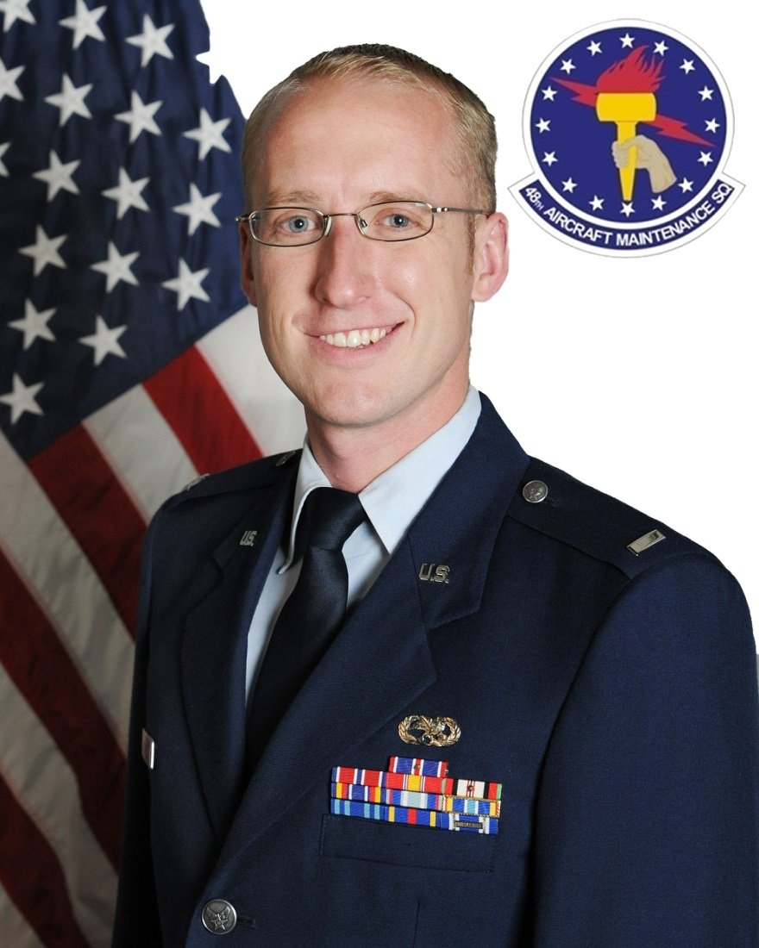
Lance P. Sijan Award(CGO)

Slide 3
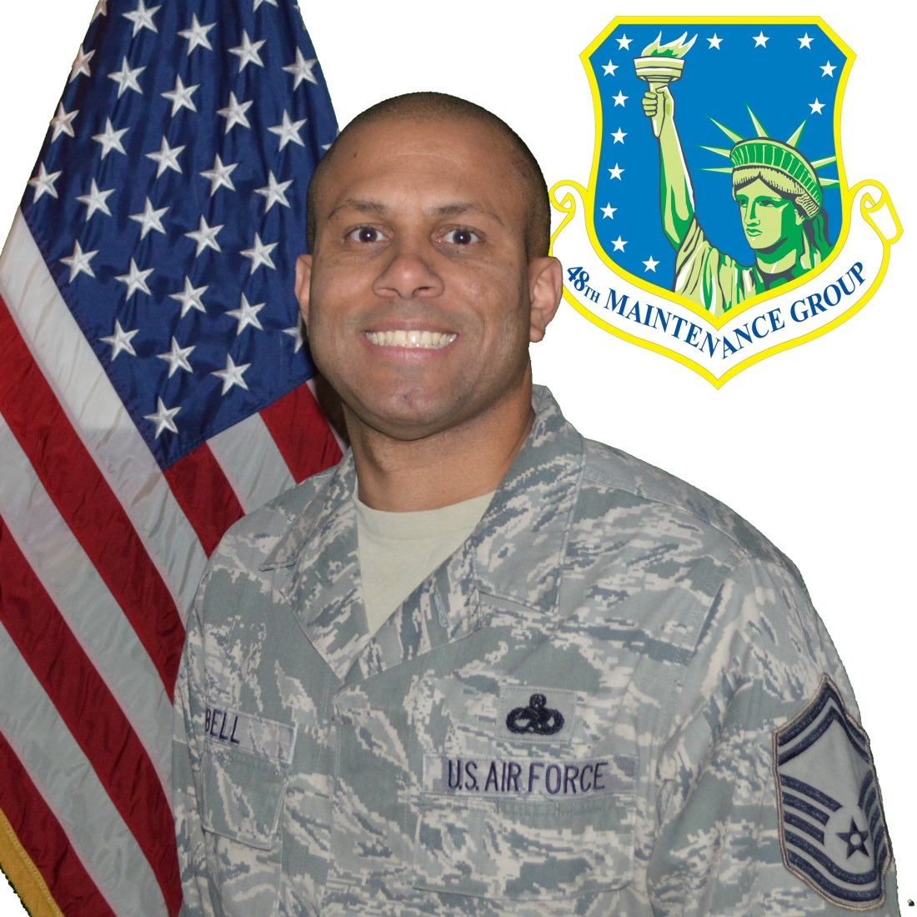
Lance P. Sijan Award(SNCO)

Slide 4
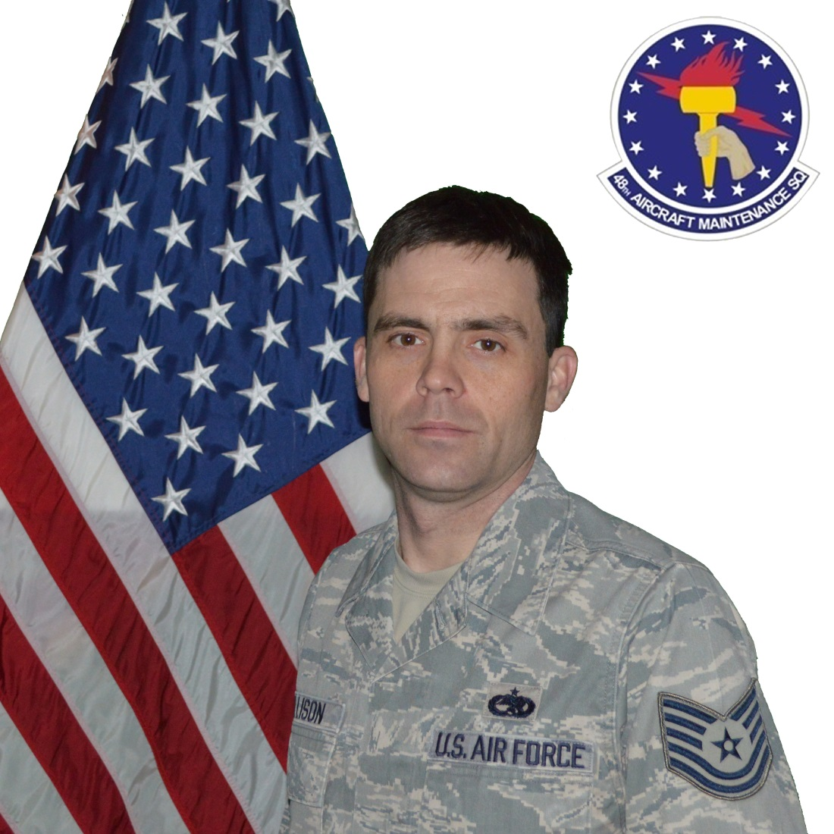
Lance P. Sijan Award(NCO)

Slide 5
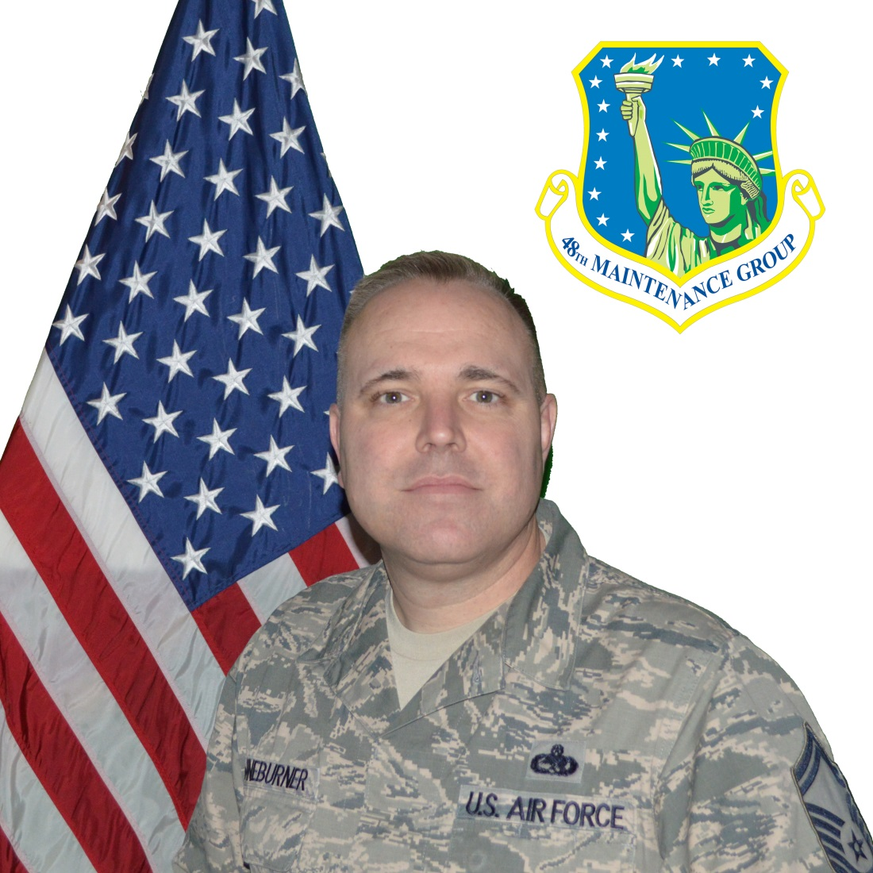
Maintenance Support Professional of the Year(SNCO)

Slide 6
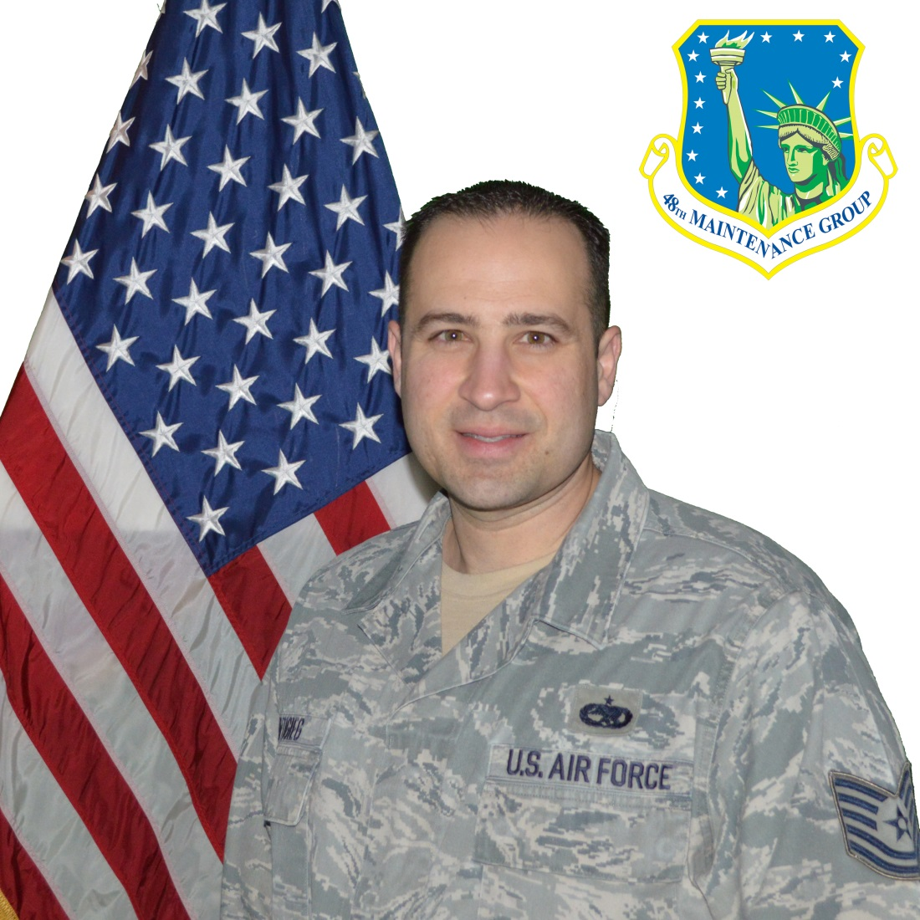
Maintenance Support Professional of the Year(NCO)

Slide 7
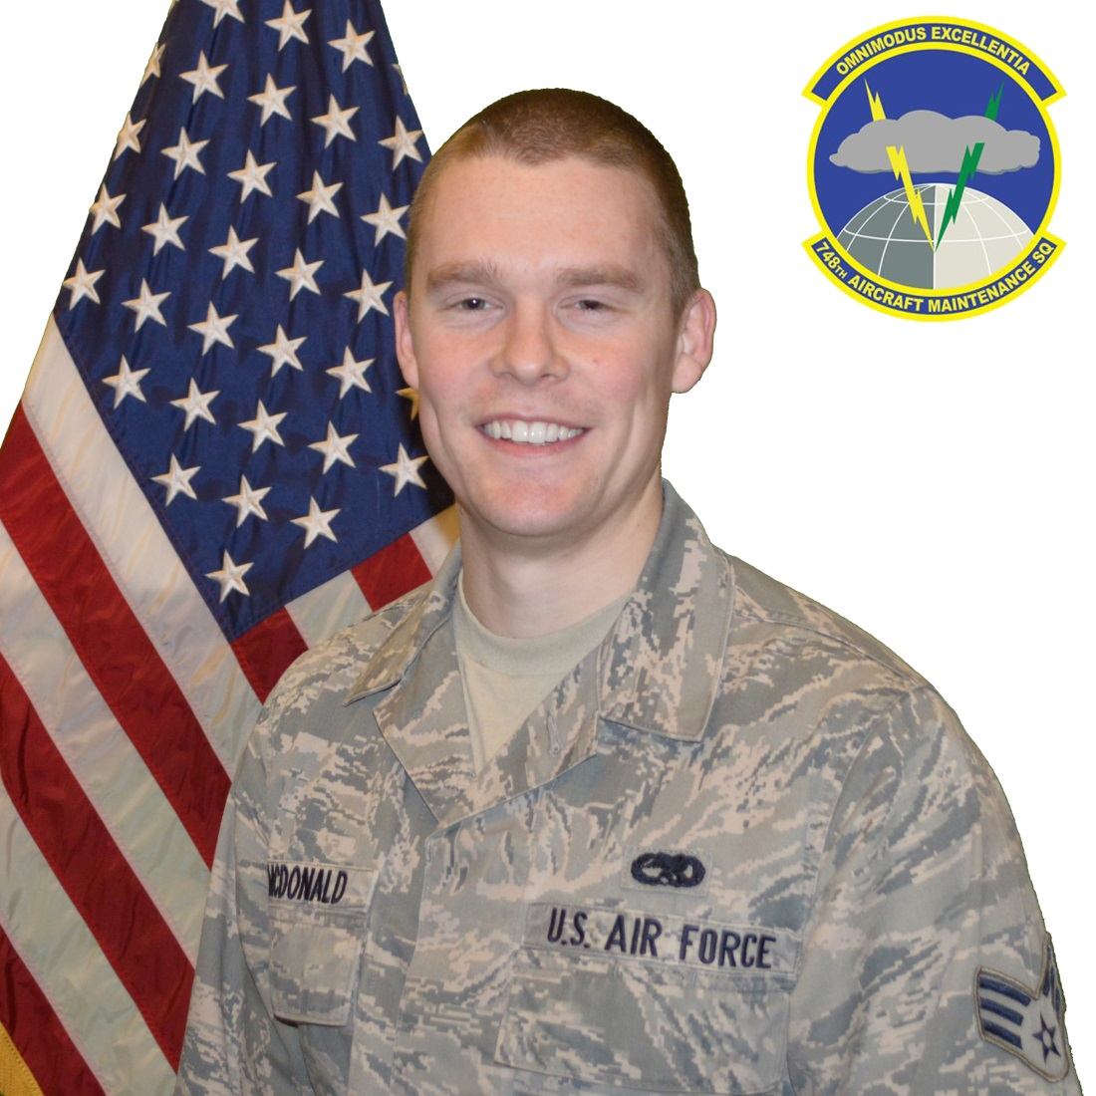
Maintenance Support Professional of the Year(Amn)

Slide 8
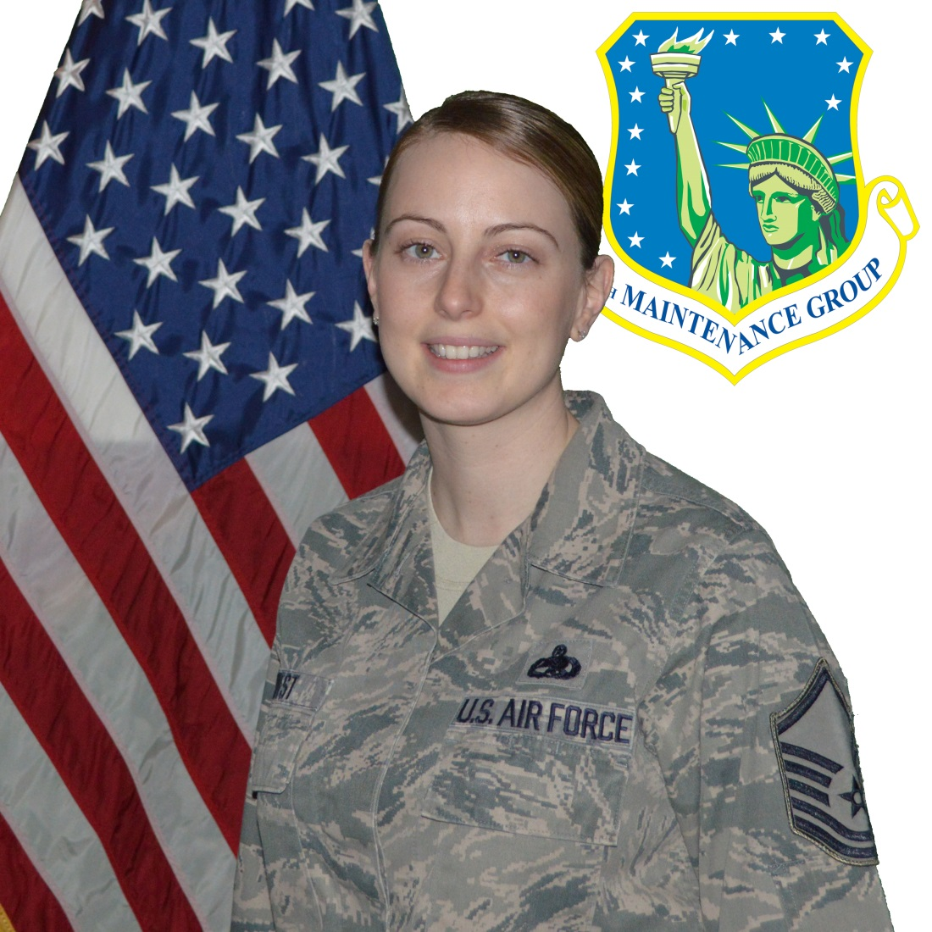
Maintenance Management Systems Plans & Scheduling Professional of the Year(SNCO)

Slide 9
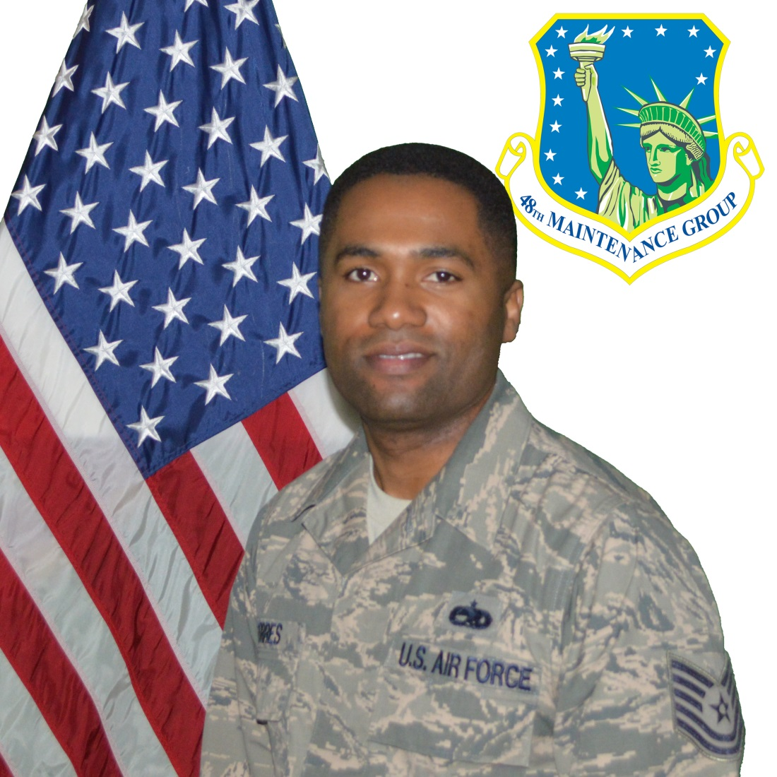
Maintenance Management Systems Plans & Scheduling Professional of the Year(NCO)

Slide 10
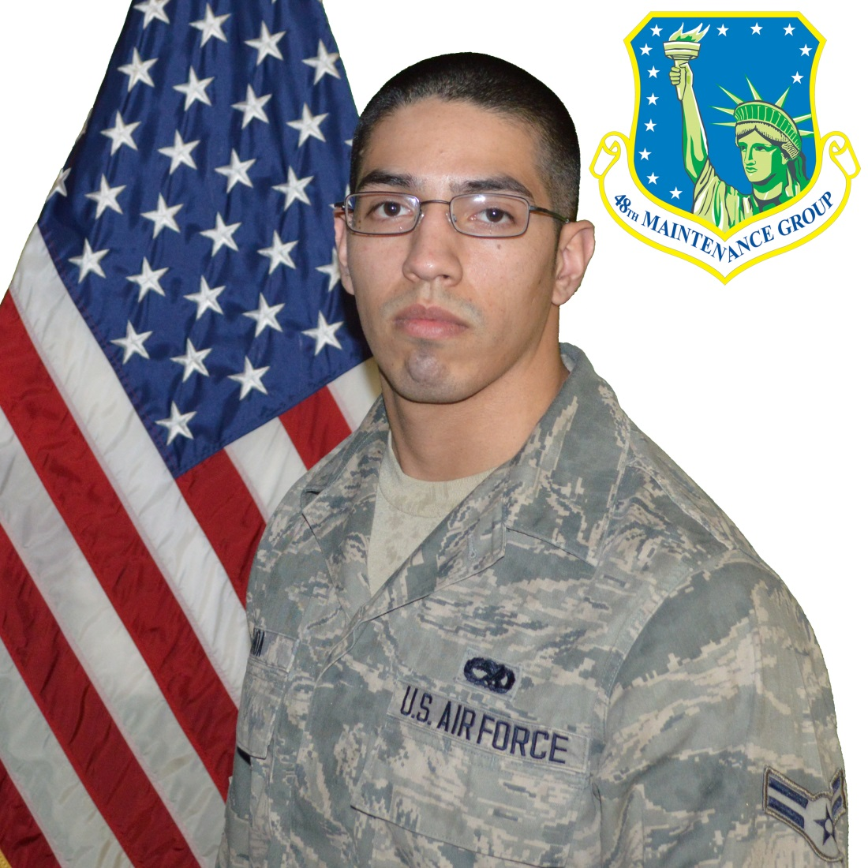
Maintenance Management Systems Plans & Scheduling Professional of the Year(Amn)

Slide 11
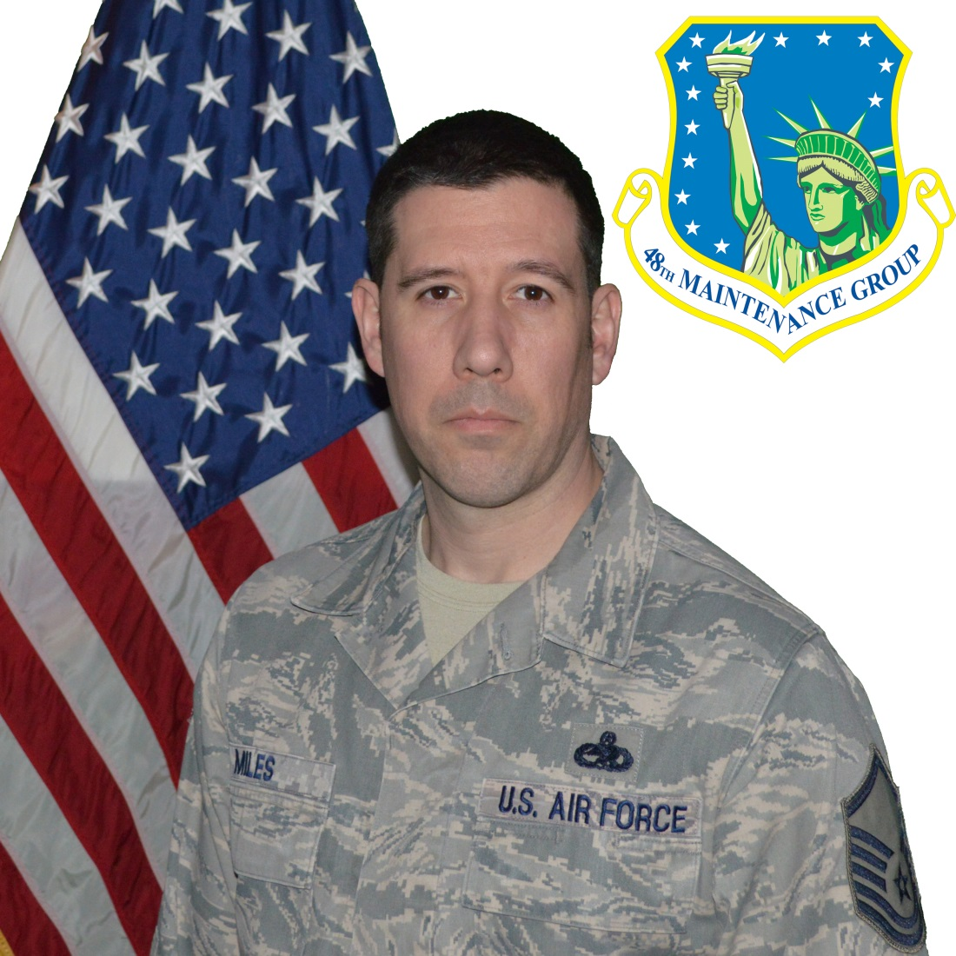
Maintenance Management Systems Analysis Professional of the Year(SNCO)

Slide 12
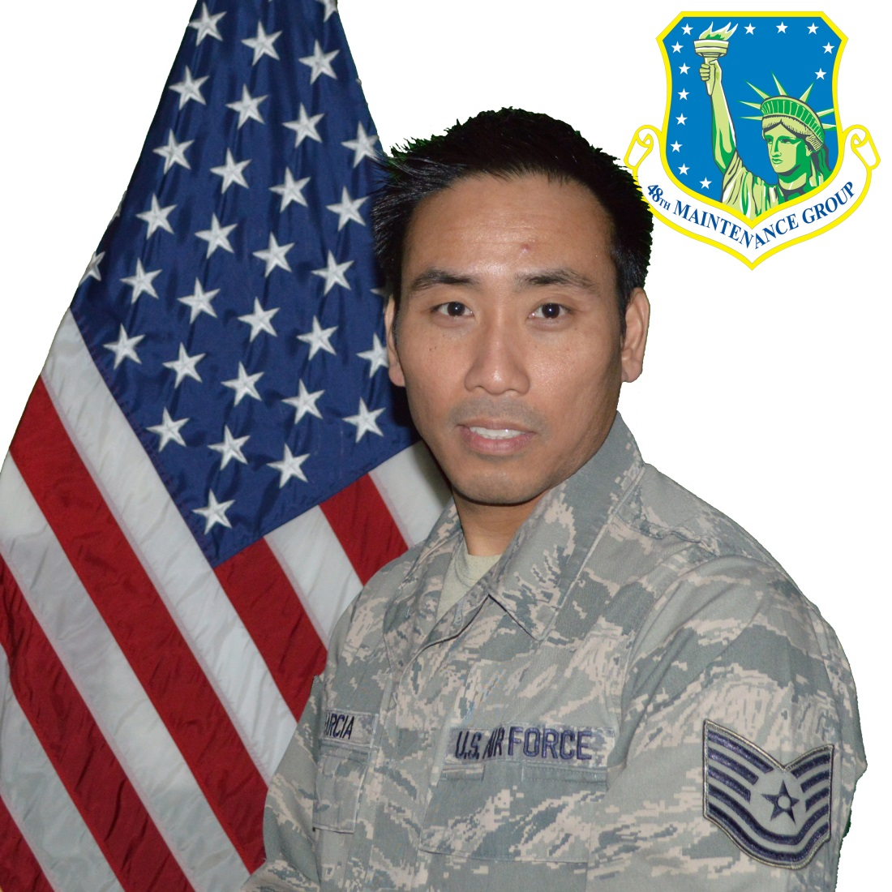
Maintenance Management Systems Analysis Professional of the Year(NCO)

Slide 13
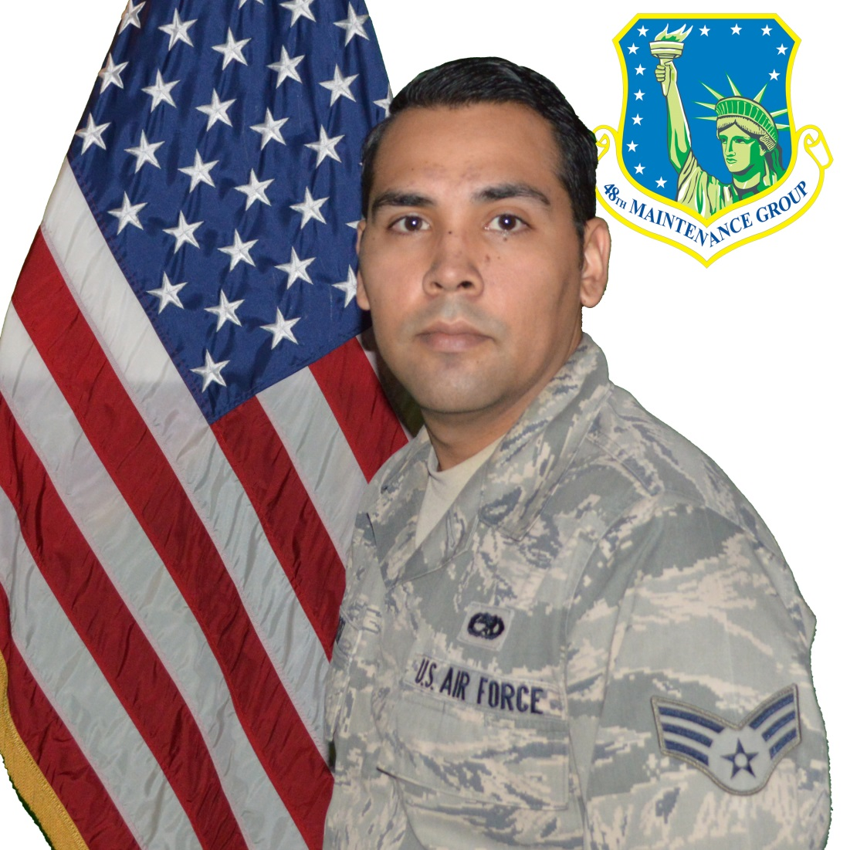
Maintenance Management Systems Analysis Professional of the Year(Amn)

Slide 14
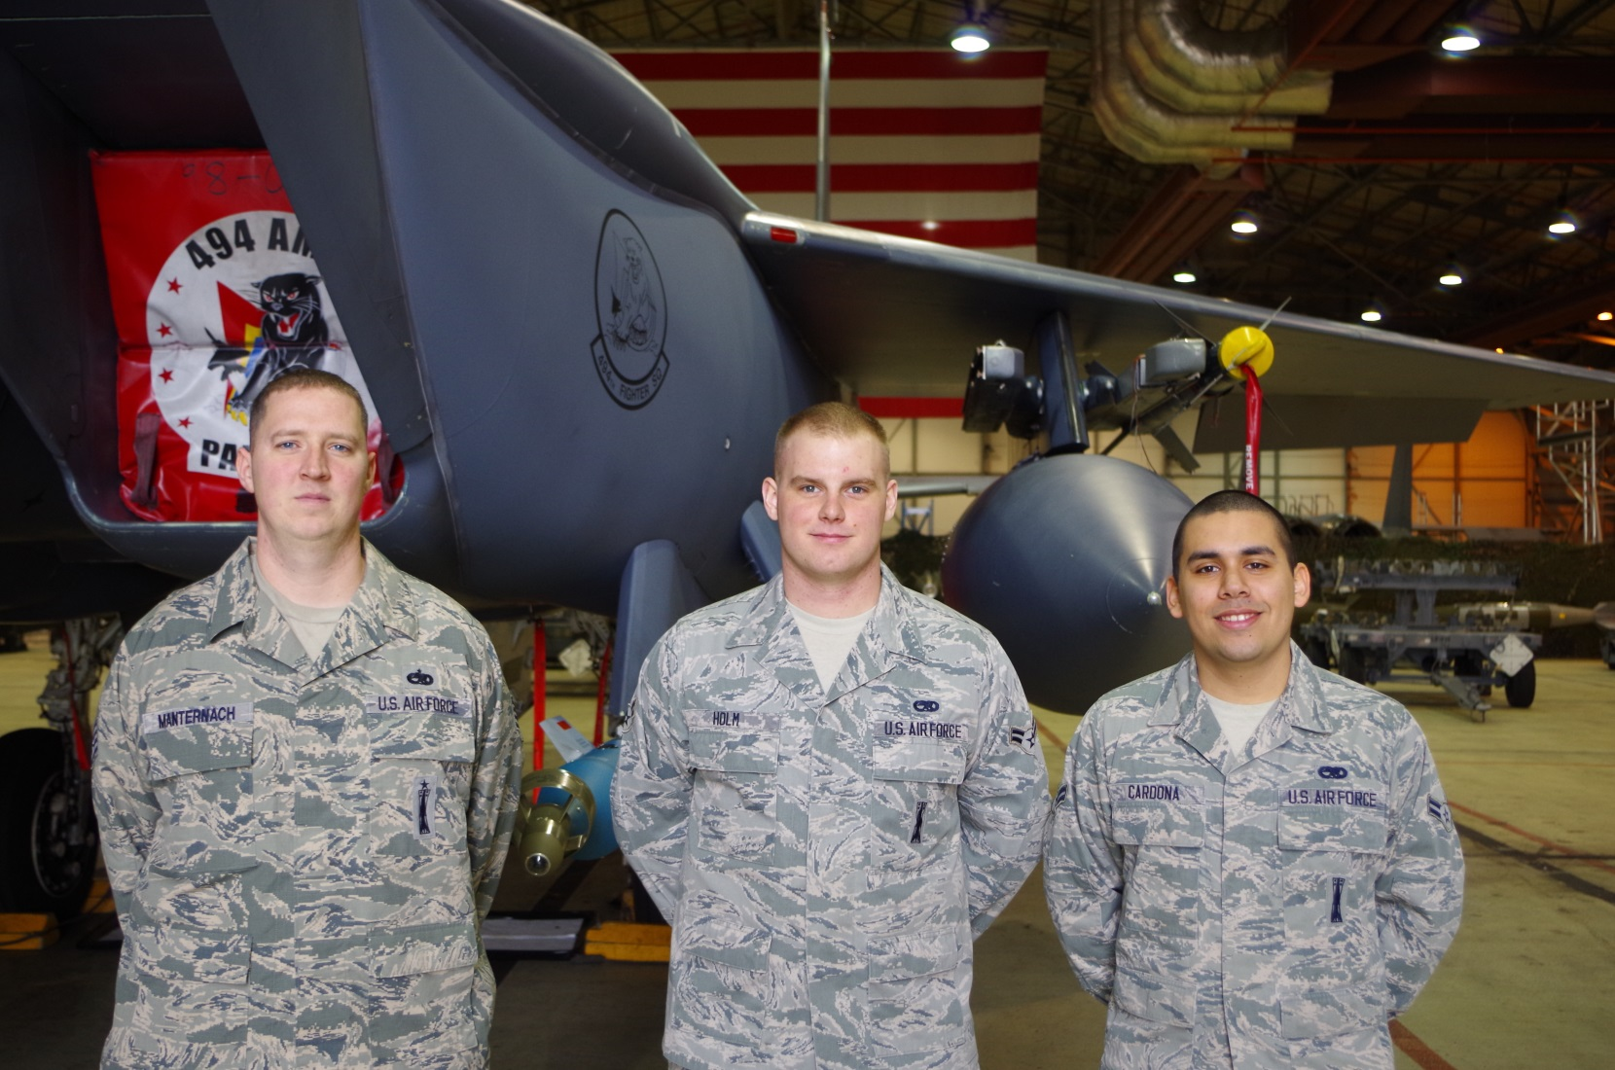
Load Crew of the Year

Slide 15
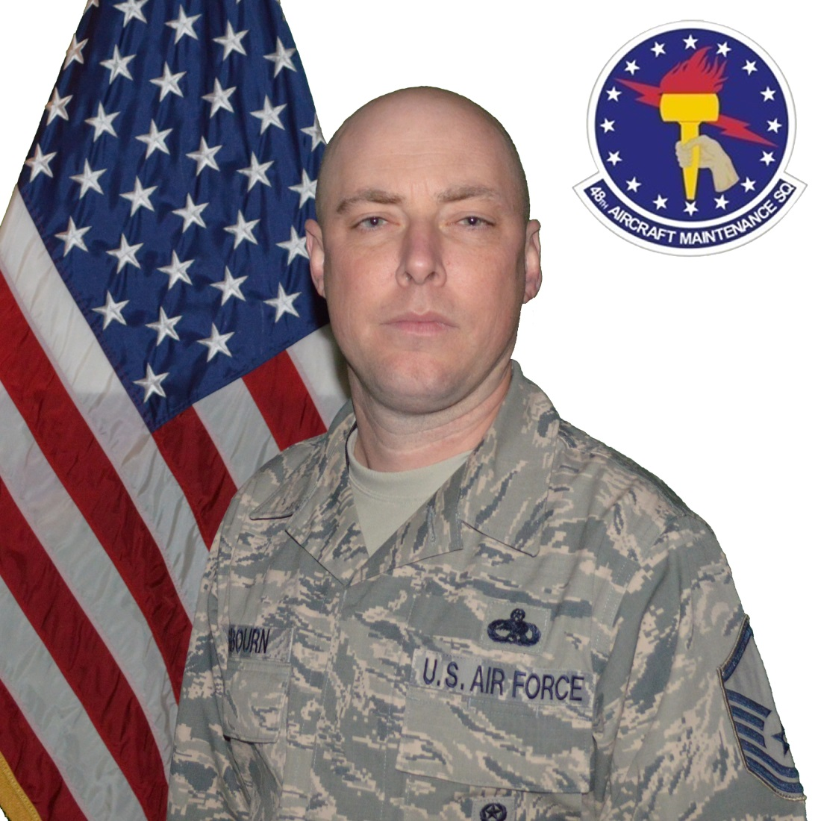
Armament Systems Manager of the Year

Slide 16
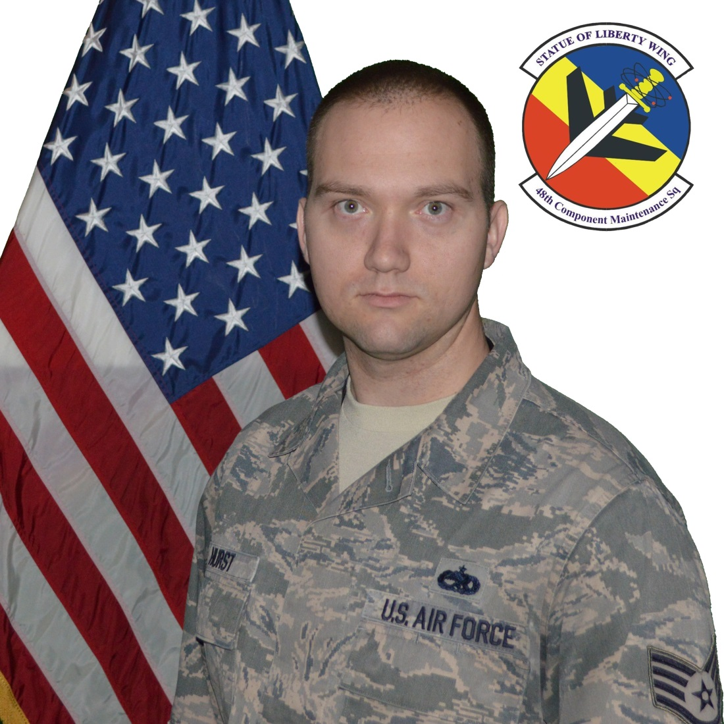
Armament Systems Supervisor of the Year

Slide 17
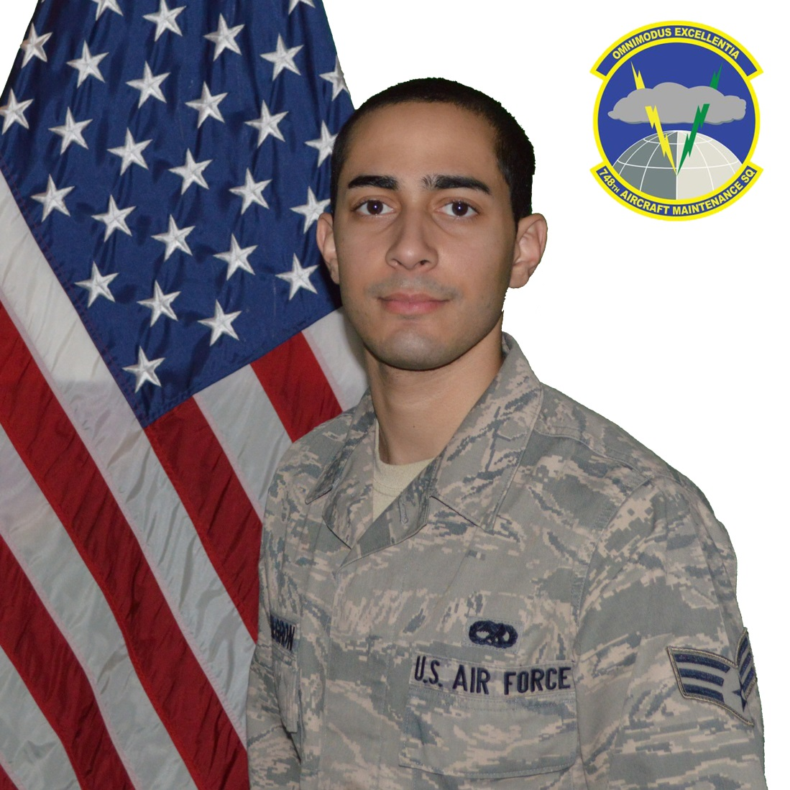
Armament Systems Technician of the Year

Slide 18
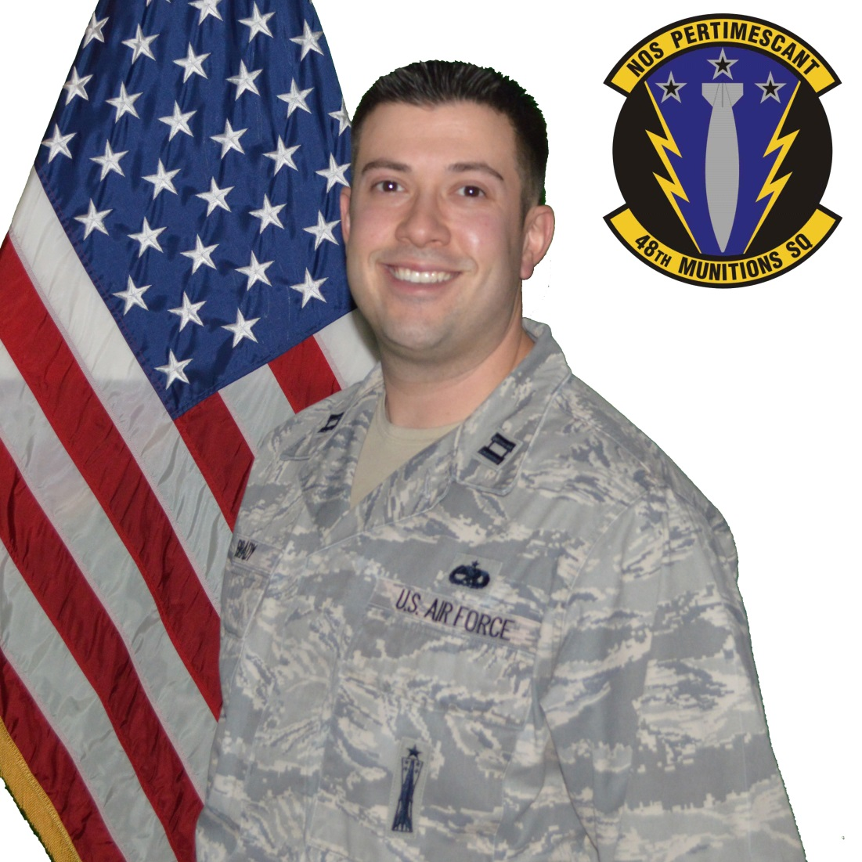
Munitions and Missile Maintenance CGO of the Year

Slide 19
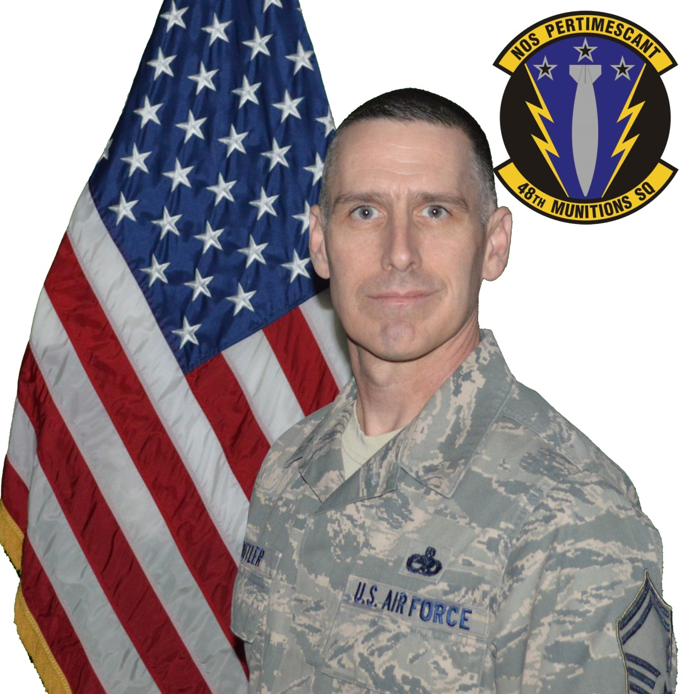
Munitions and Missile Maintenance Manager of the Year

Slide 20
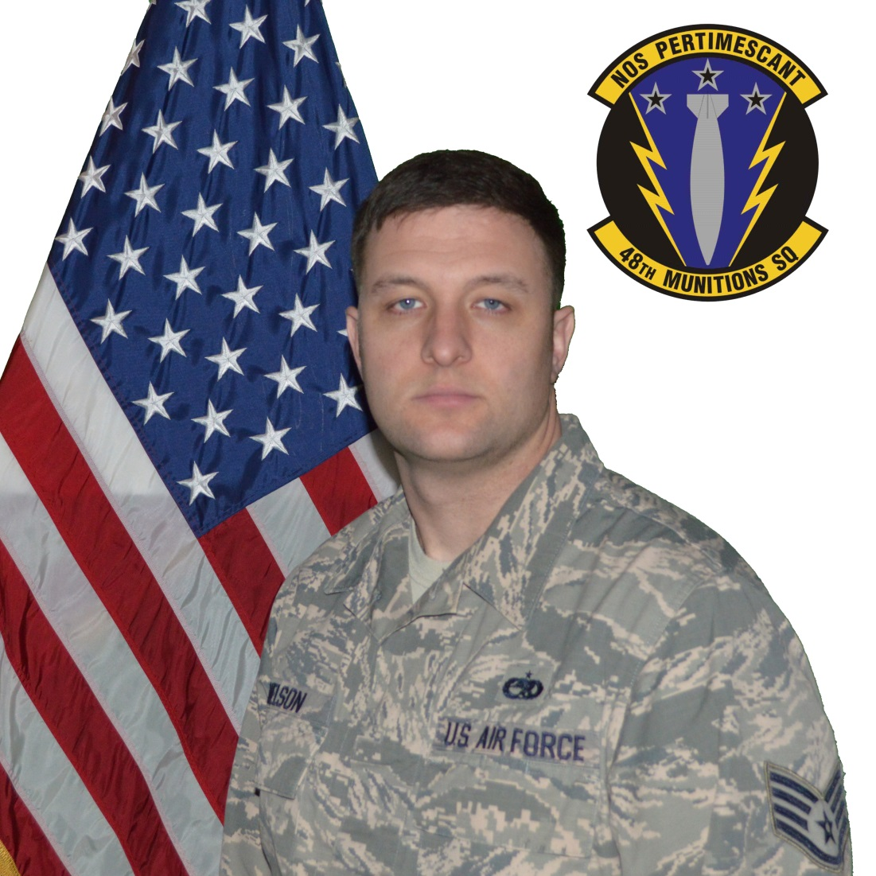
Munitions and Missile Maintenance Supervisor of the Year

Slide 21
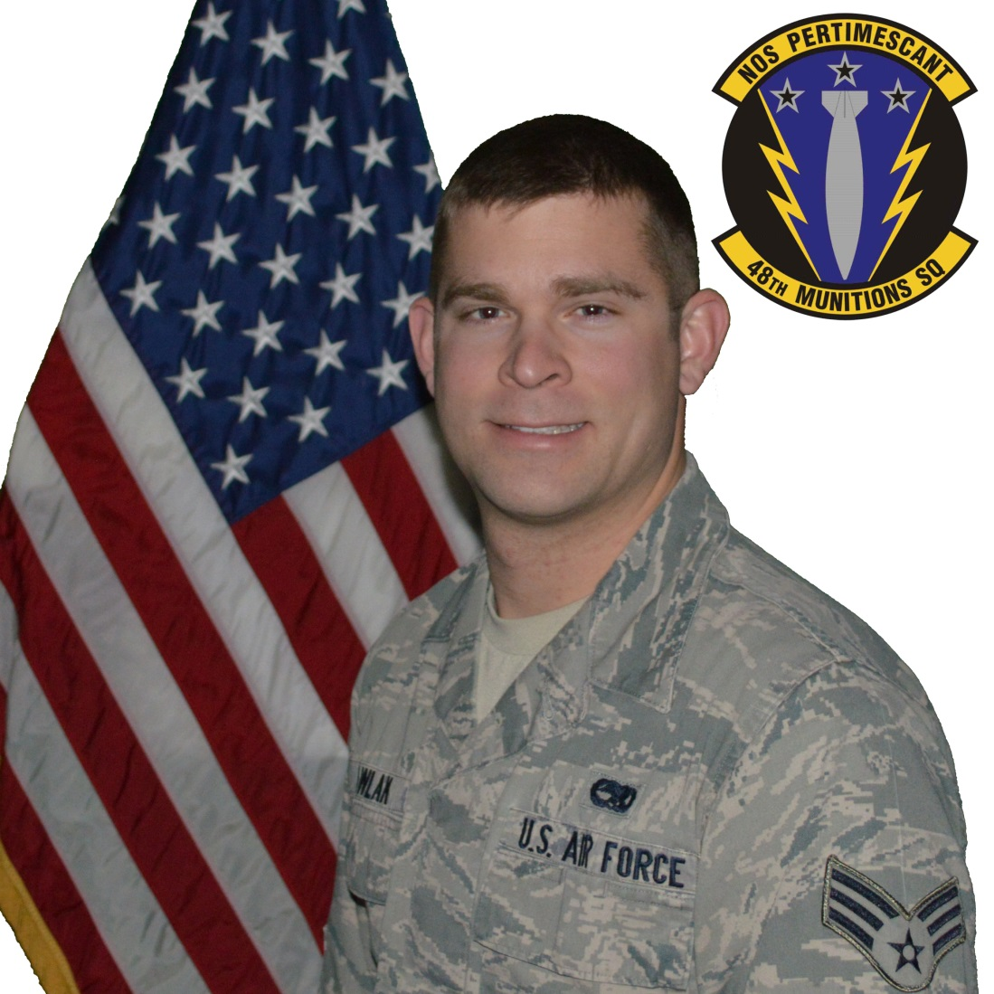
Munitions and Missile Maintenance Technician of the Year

Slide 22
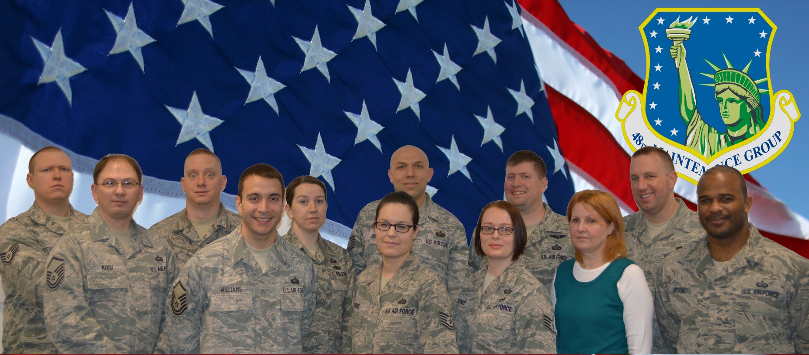
Maintenance Training Flight of the Year

Slide 23
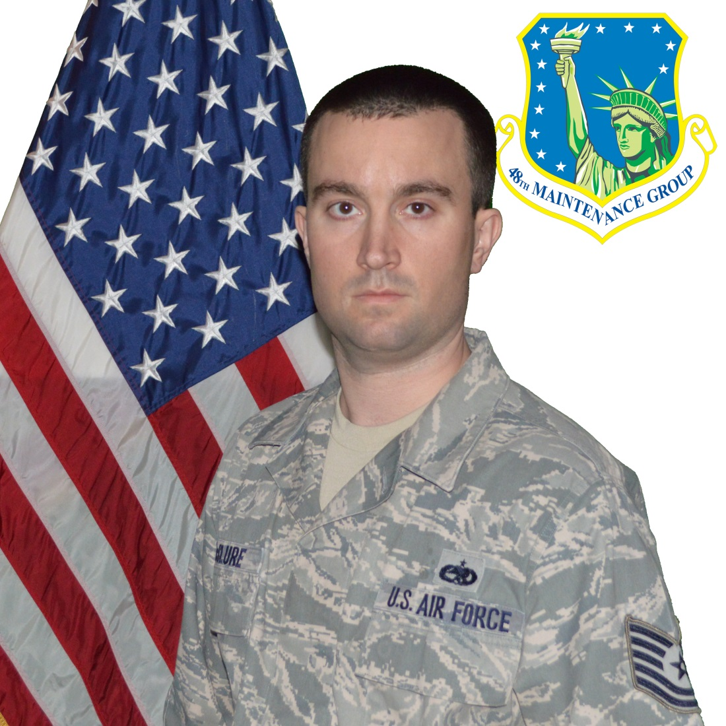
Maintenance Training Instructor of the Year

Slide 24
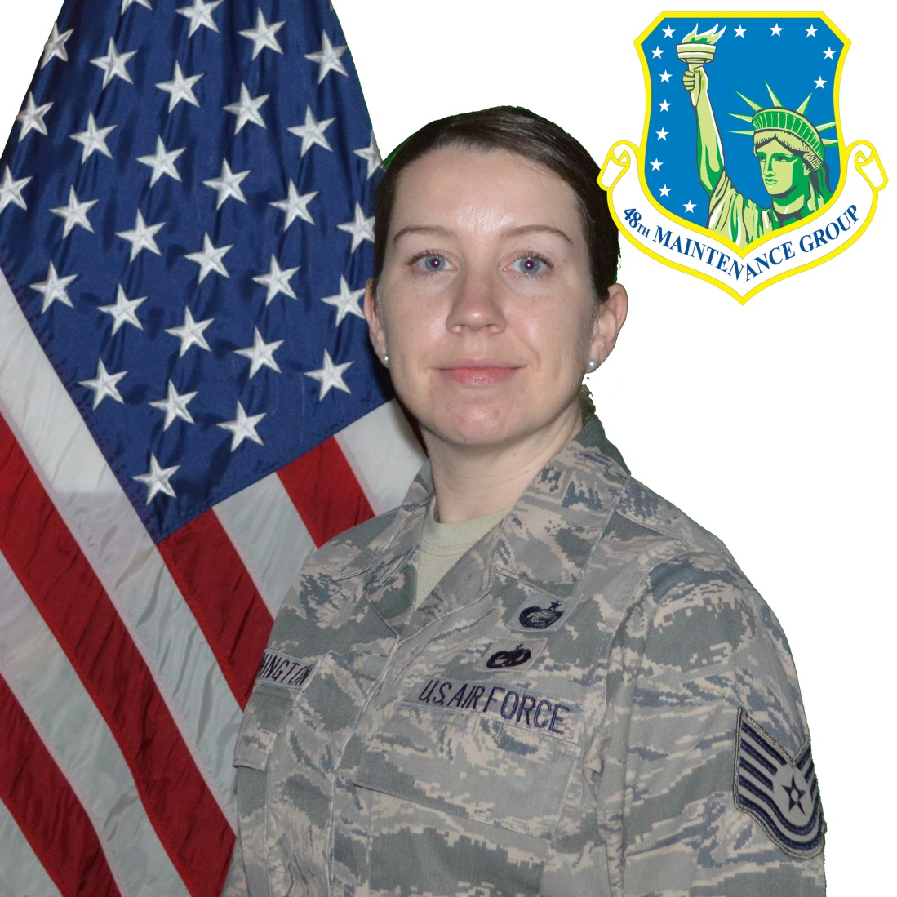
Training Manager of the Year

Slide 25
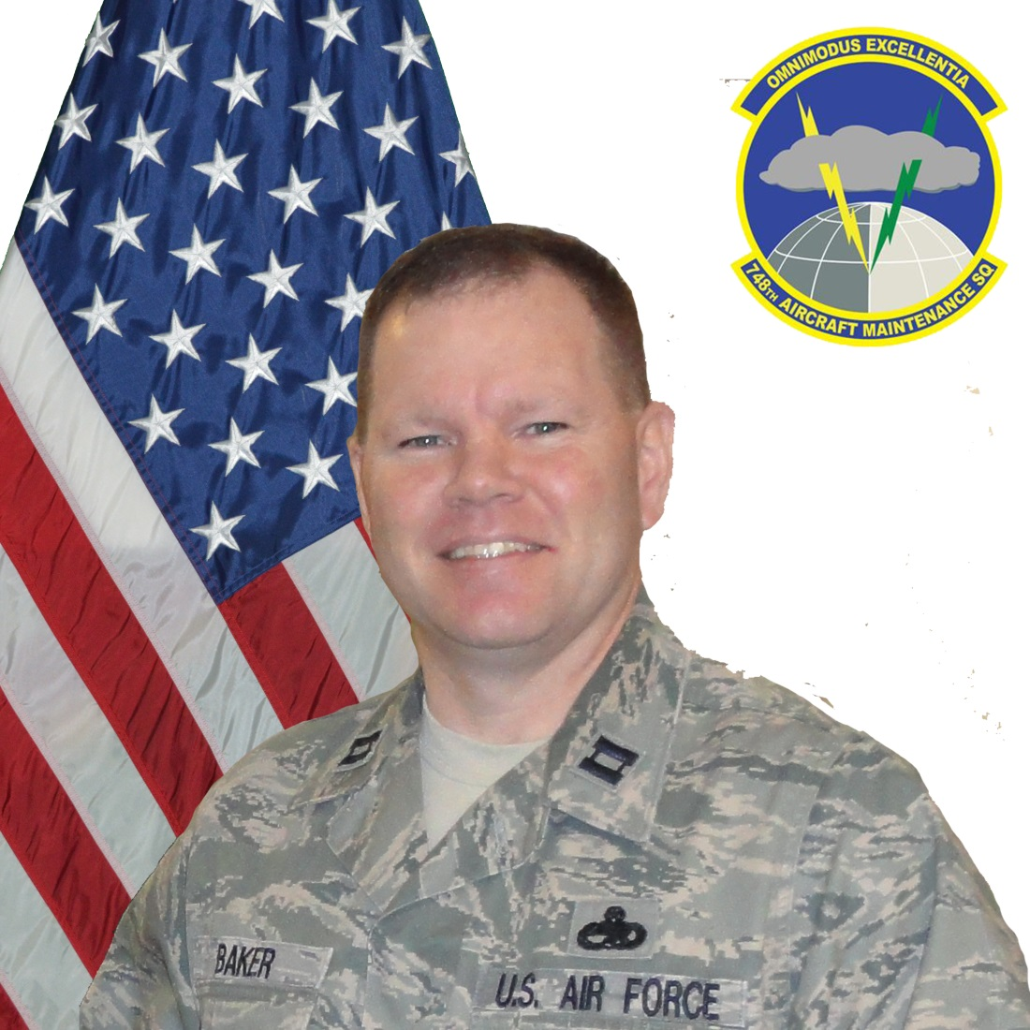
General Lew Allen Jr. Award(Officer)

Slide 26
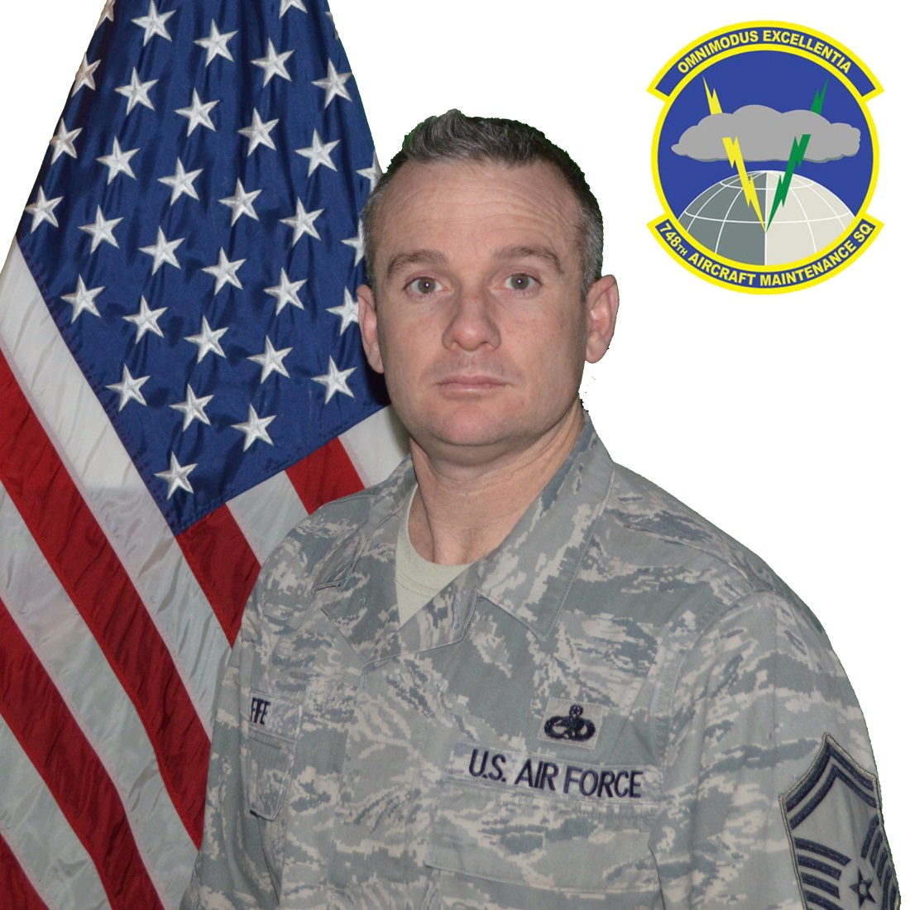
General Lew Allen Jr. Award(SNCO)

Slide 27
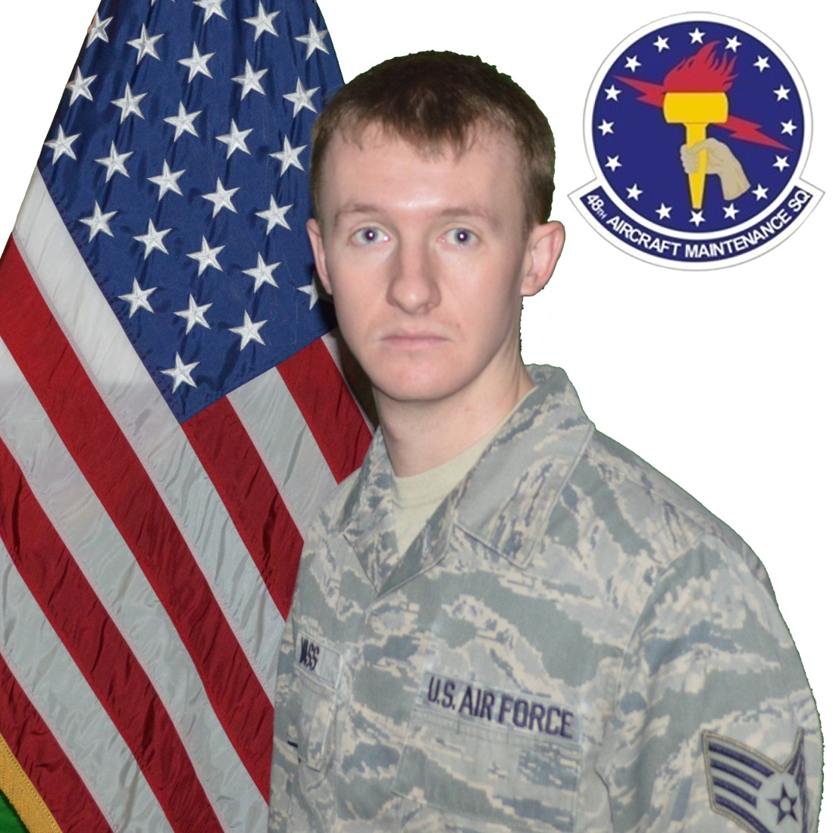
CMSgt Thomas N. Barnes Award

Slide 28
Lt Gen Leo Marquez Outstanding Munitions and Missile CGO

Slide 29
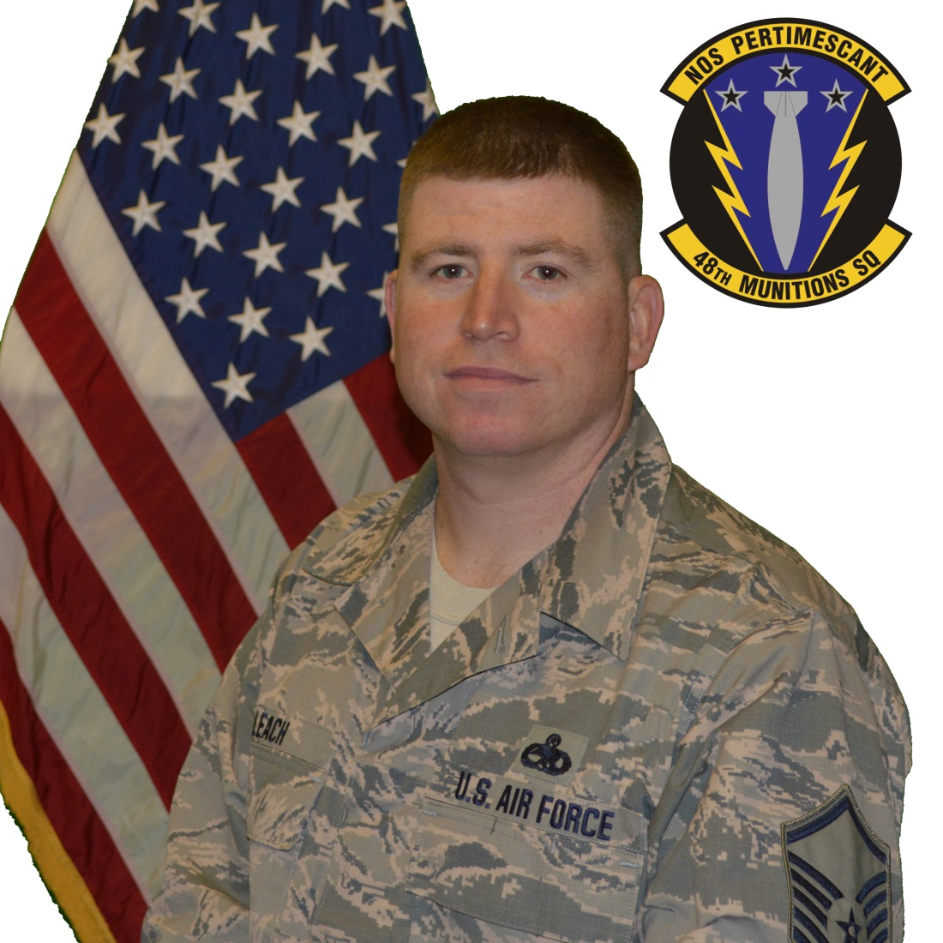
Lt Gen Leo Marquez Outstanding Munitions and Missile Manager of the Year

Slide 30
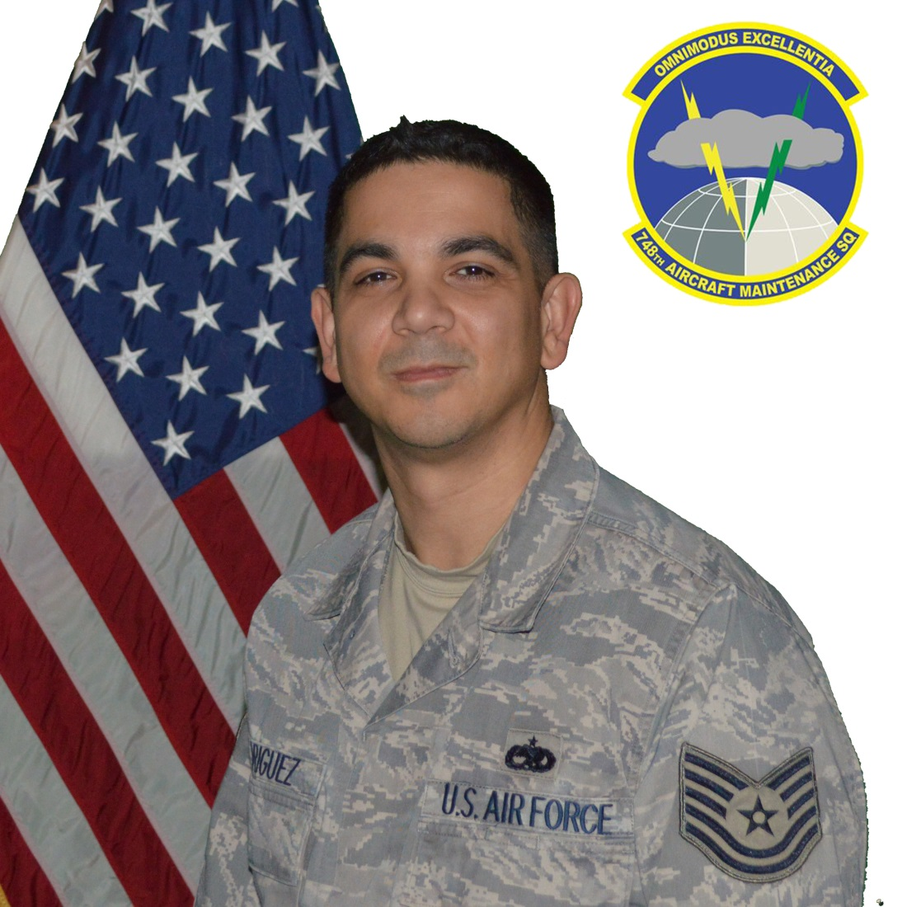
Lt Gen Leo Marquez Outstanding Munitions and Missile Supervisor of the Year

Slide 31
Lt Gen Leo Marquez Outstanding Munitions and Missile Technician of the Year

Slide 32
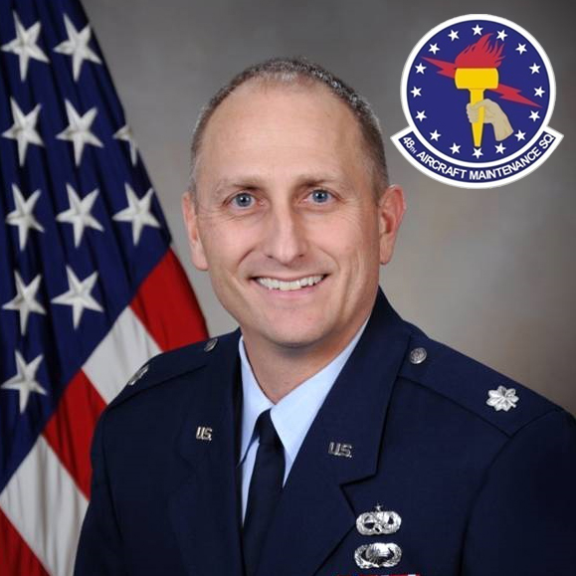
Lt Gen Leo Marquez Outstanding Aircraft Maintenance FGO

Slide 33
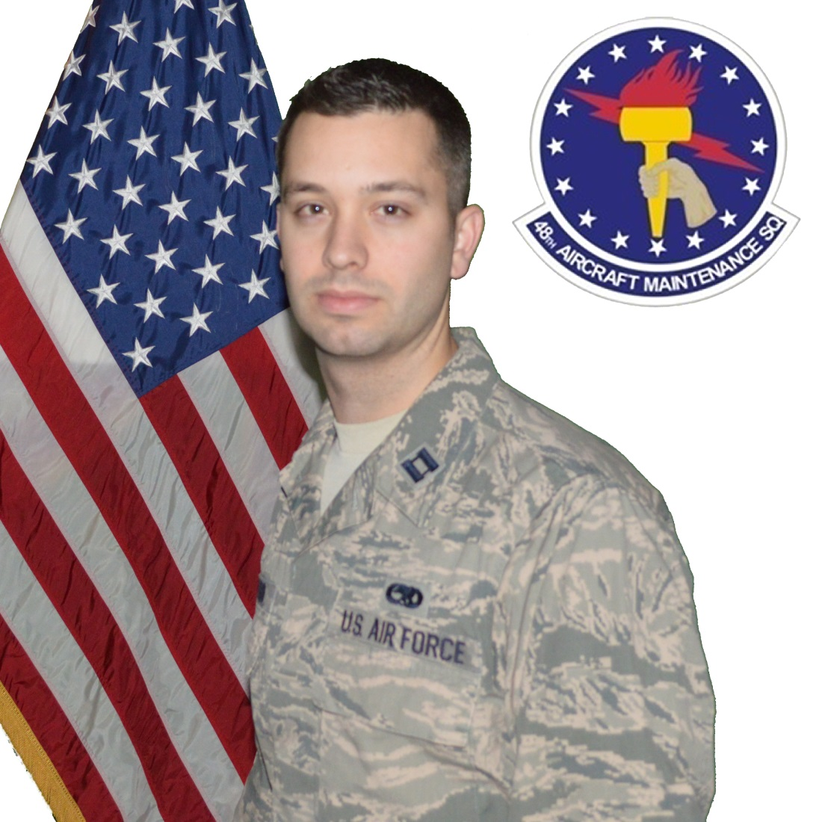
Lt Gen Leo Marquez Outstanding Aircraft Maintenance CGO

Slide 34
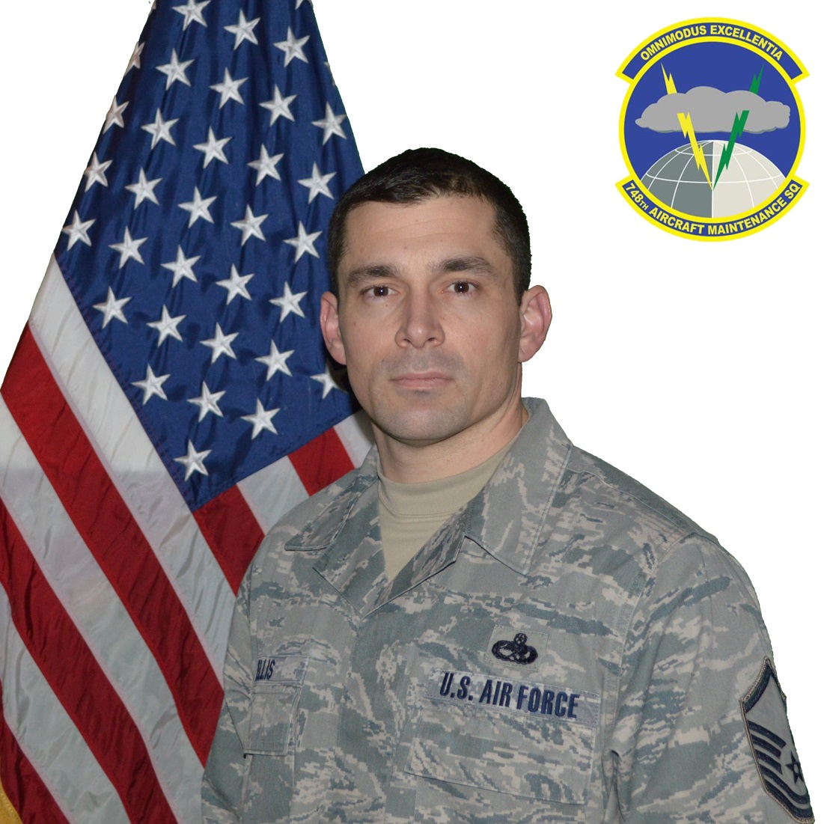
Lt Gen Leo Marquez Outstanding Aircraft Maintenance Manager of the Year

Slide 35
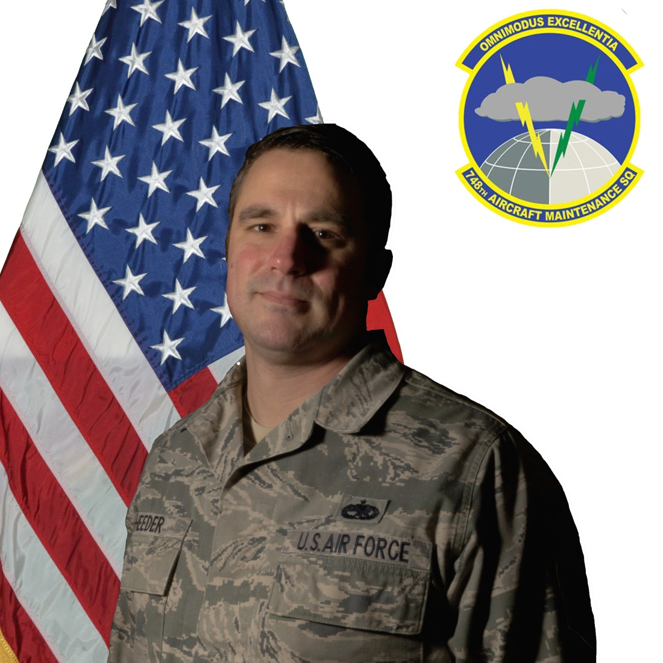
Lt Gen Leo Marquez Outstanding Aircraft Maintenance Supervisor of the Year

Slide 36
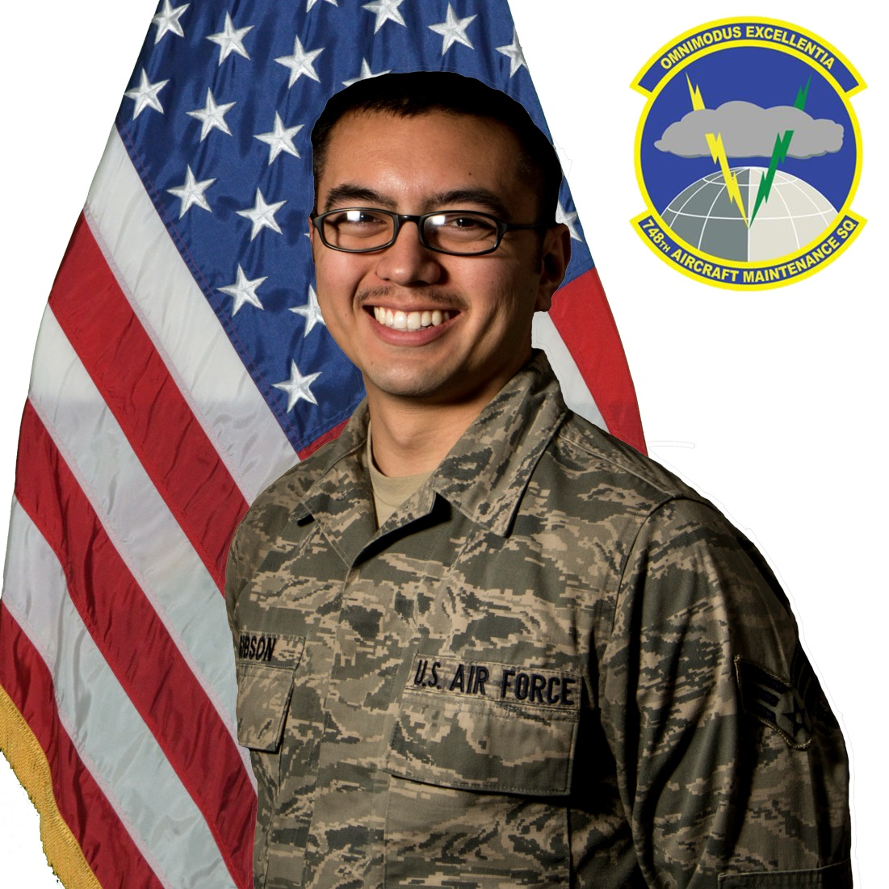
Lt Gen Leo Marquez Outstanding Aircraft Maintenance Technician of the Year

Slide 37
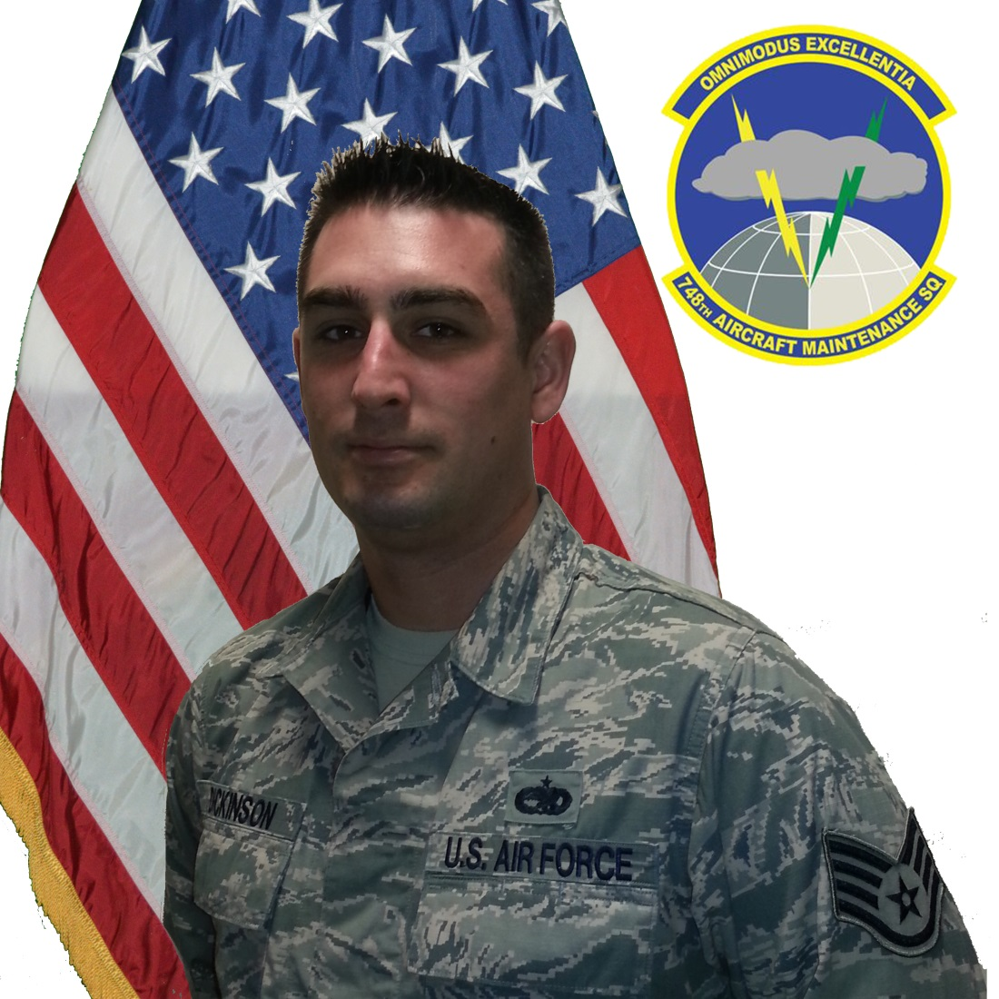
Specialist of the Year(NCO)

Slide 38
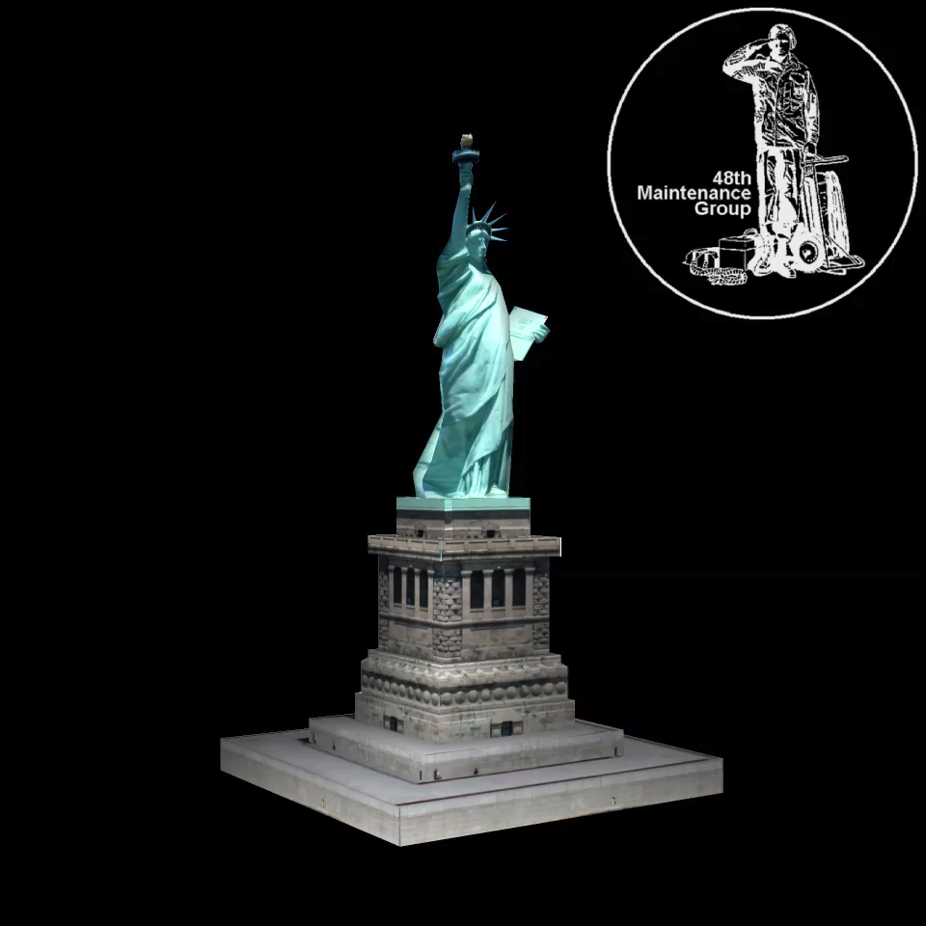
Specialist of the Year(Amn)
SrA Michael Mac Farlane

Slide 39
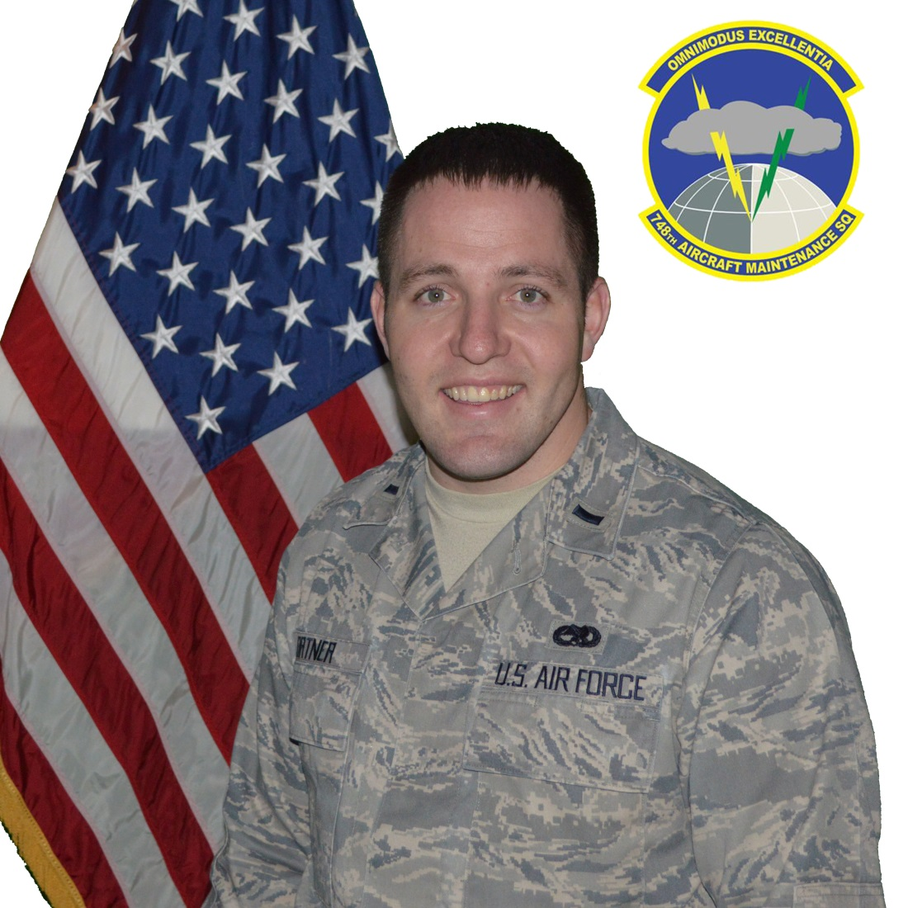
Maintenance Professional of the Year(CGO)

Slide 40
Maintenance Professional of the Year(SNCO)

Slide 41
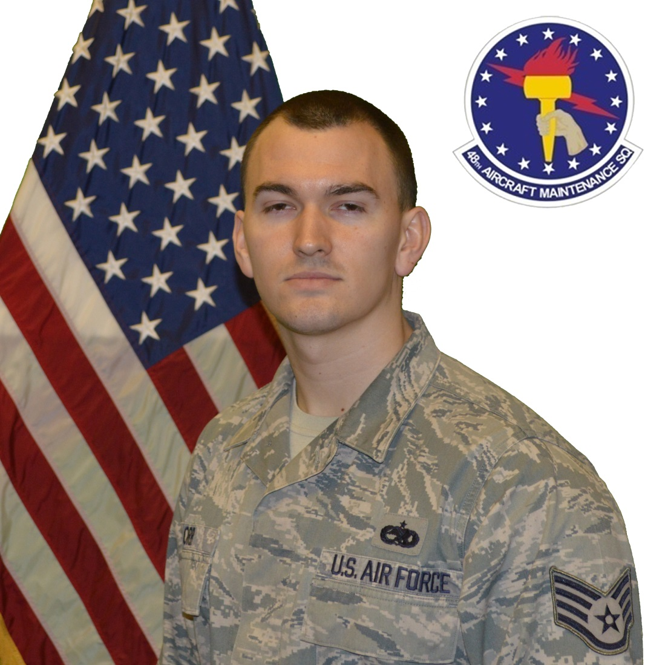
Maintenance Professional of the Year(NCO)

Slide 42
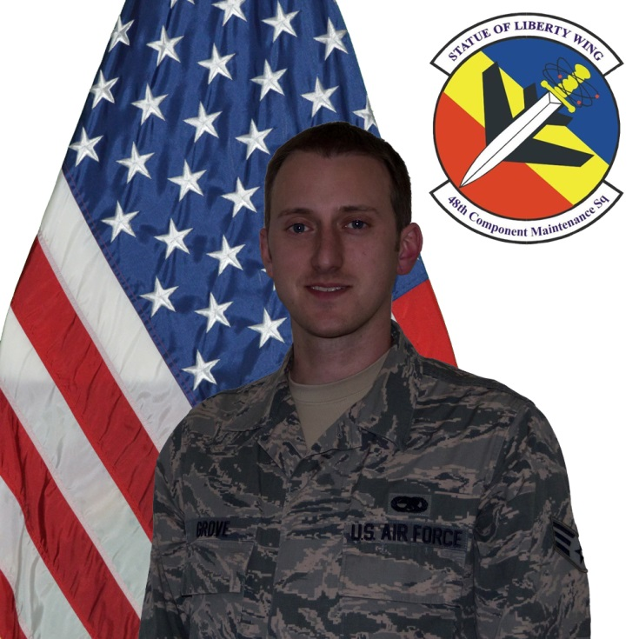
Maintenance Professional of the Year(Amn)

